Slide 1



AquaHawk Customer Portal
Enhancing the User Experience
August 26, 2025
Notes:
Be prepared to answer:
Limit to number of users per account?
What happens if there is interference, or something blocking meter?
Can residents pay their bills on this system?
Other languages?

Slide 2

How Does AquaHawk Benefit Customers?
Simple
  Easy access to your water usage on any device
Control your Bill
    Monitor your water usage in dollars
    Be notified when your usage is trending higher than usual
Customized Notifications
    Receive alerts by your choice (text, email, or phone)
    Set usage notices to avoid surprises on bills
Identify Leaks Early
  Save money and water while helping prevent property damage

Slide 3
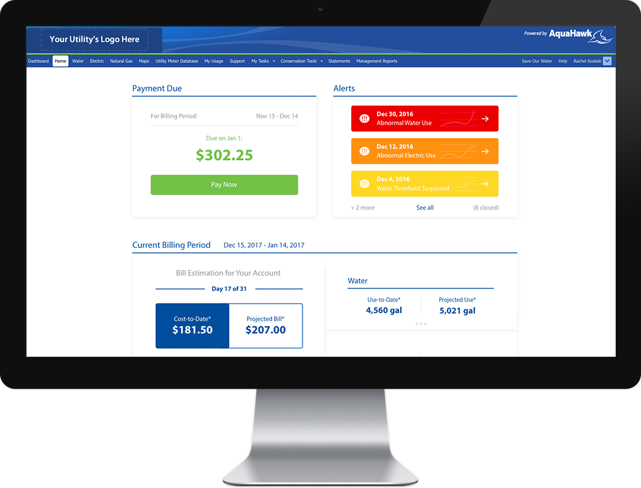
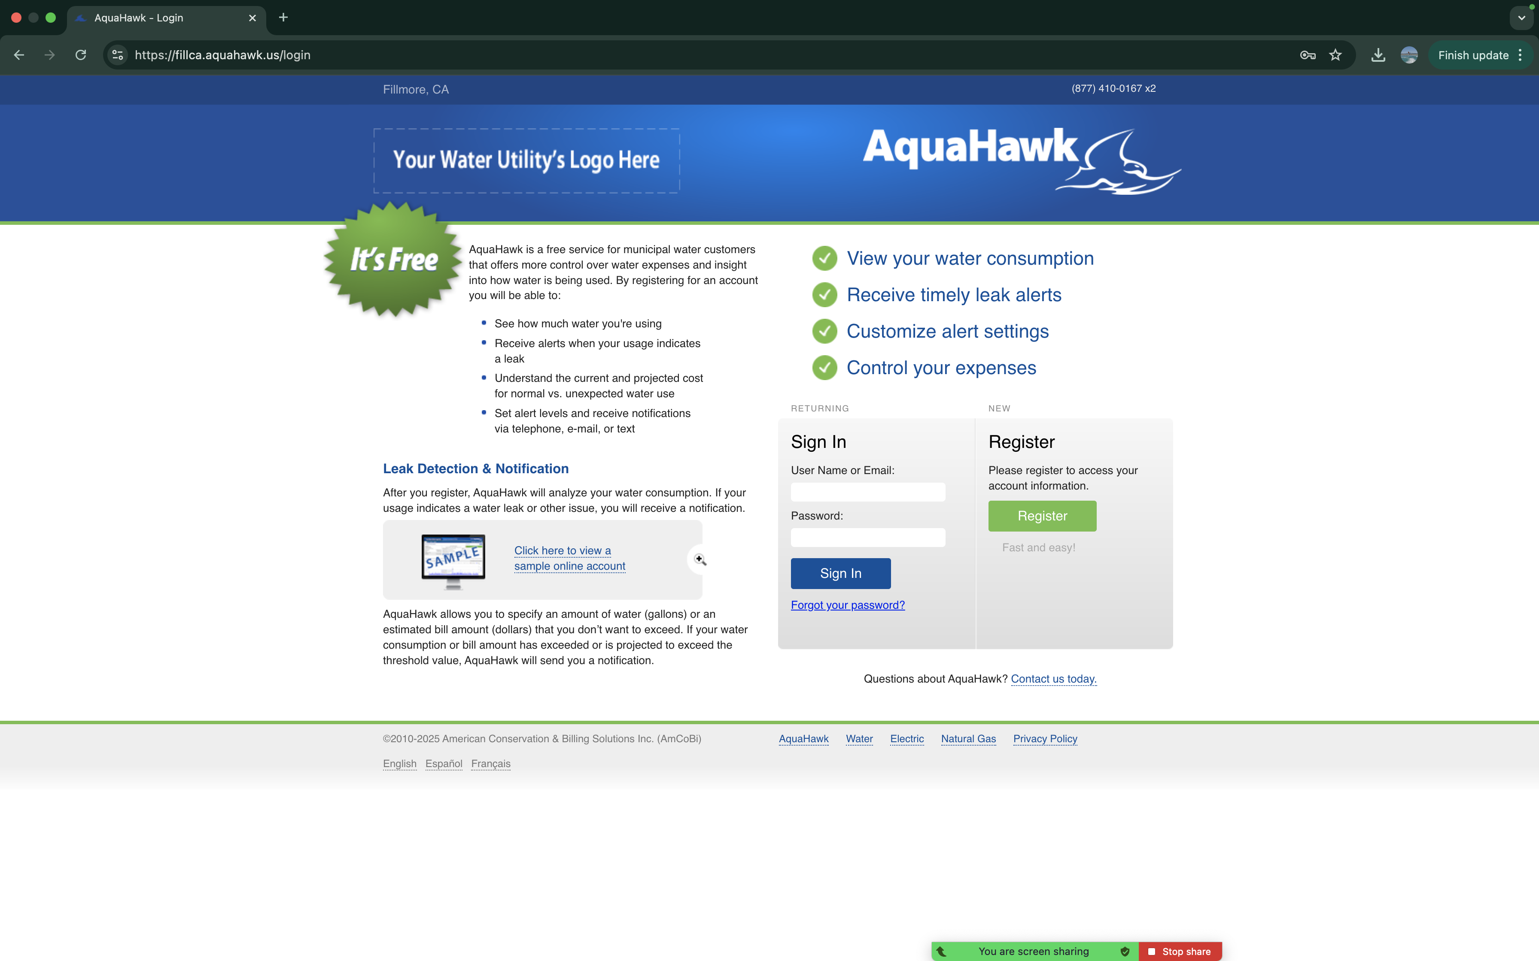
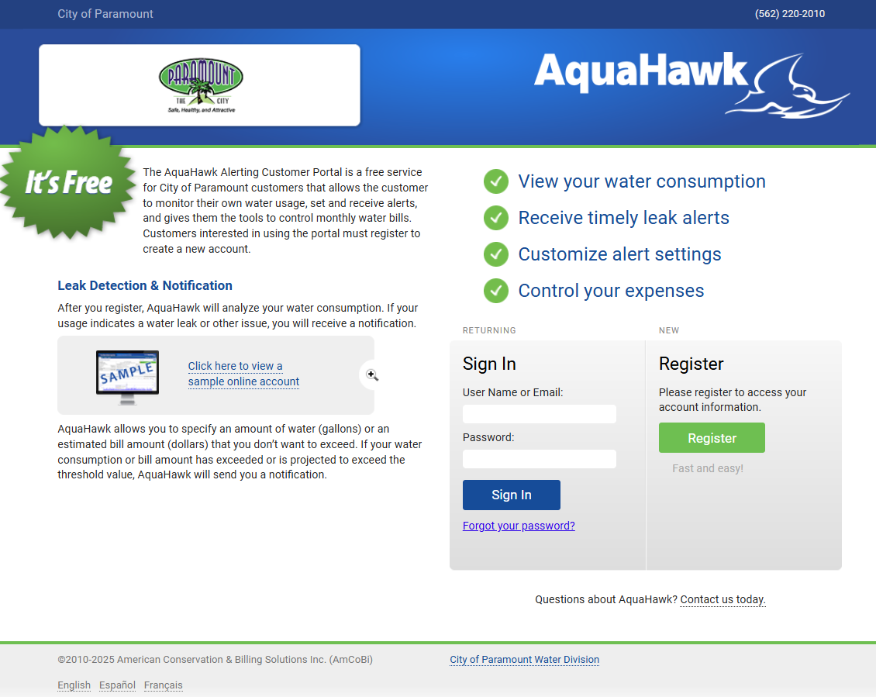
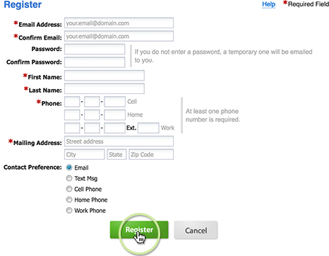

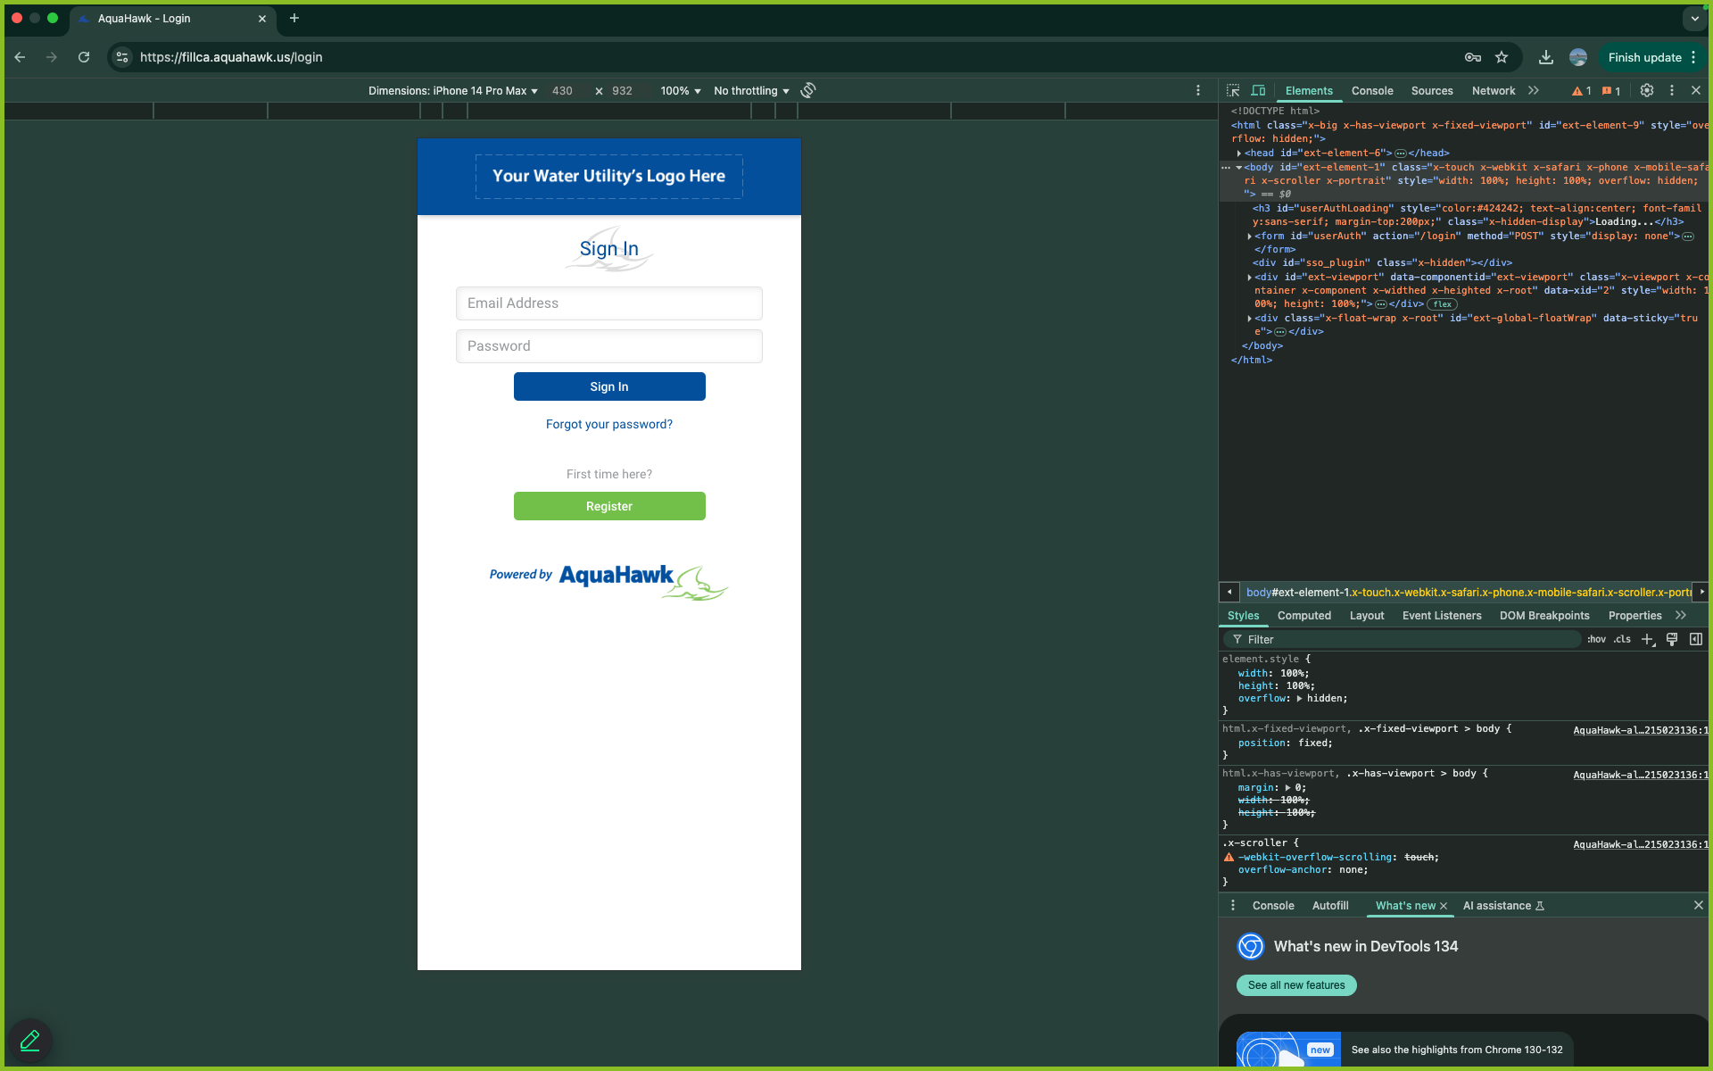
How to Register for AquaHawk?
Simple Sign Up
  All you need is your utility bill
    Account Number (top of your bill)
    Contact Information
  Accessible from any device
Notes:
Web-based portal, no app. Not required to download anything. Just access it via your browser. Designed for your phone, so that when you log in via your phone, everything will be sized for that screen.
DISCUSS ALL LANGUAGES (note the switch at bottom left of the big screen image)

Slide 4
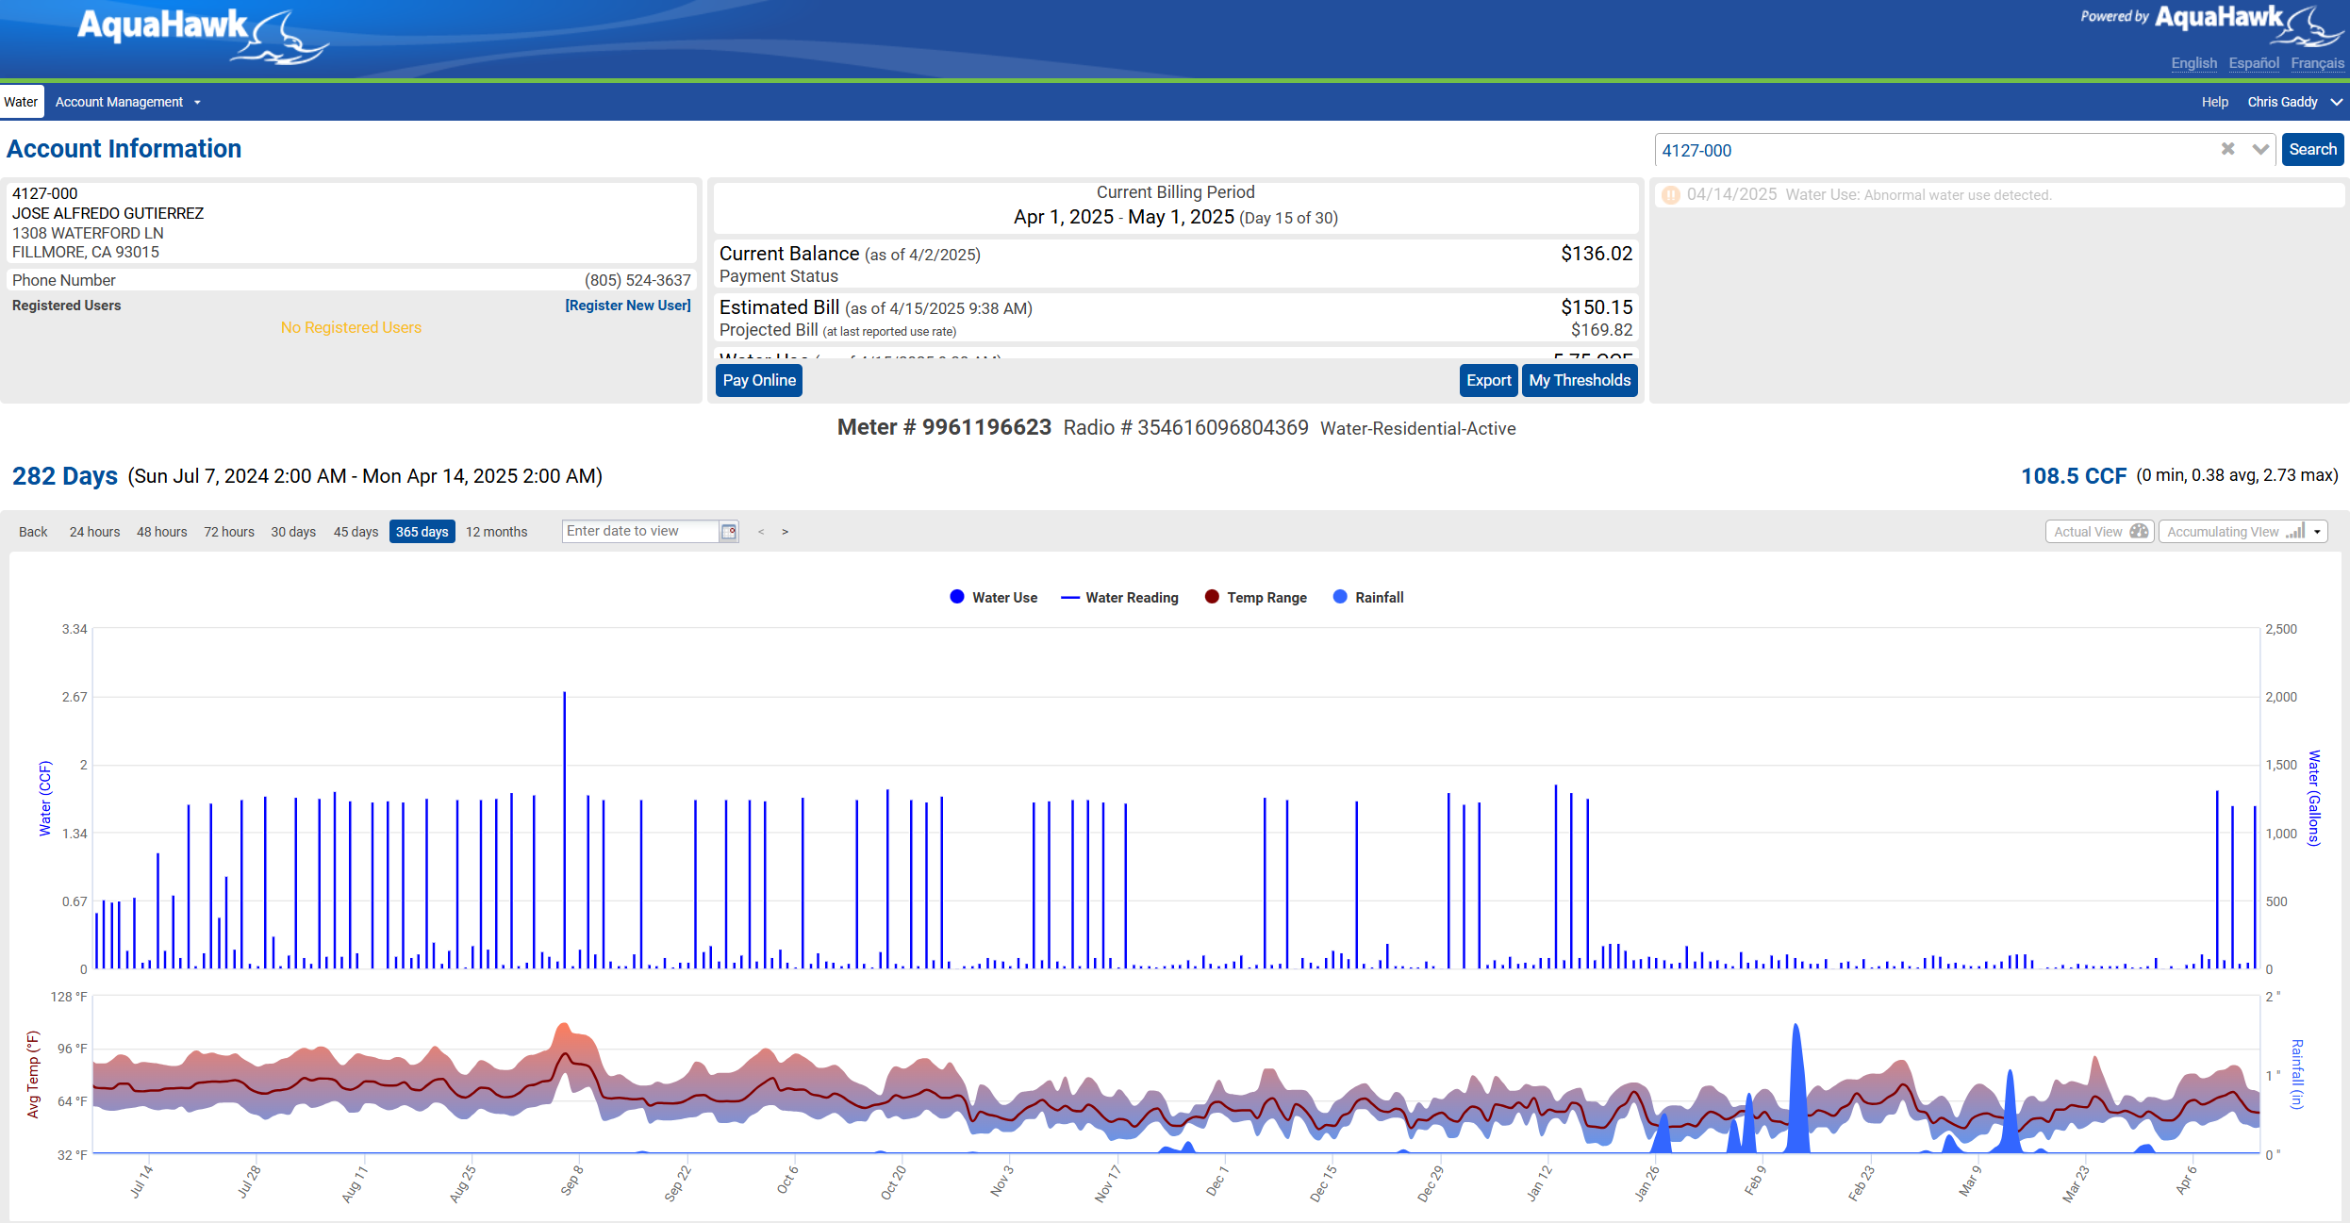
How to Navigate the AquaHawk Portal?
View your usage across different time periods at the bottom of the page.
00111-011
John Doe
1234 Main St.
PARAMOUNT, CA 97023
(310) 000-0000
01111111111

Slide 5
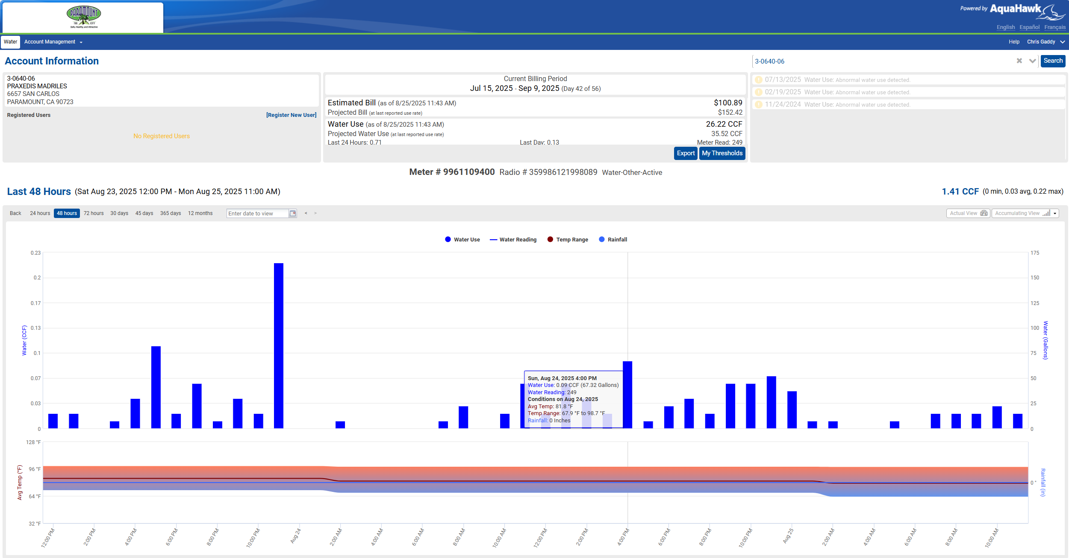
How to Navigate the AquaHawk Portal?
Zoom-in on usage by selecting timeframe at the top-left. Hover over specific period to see additional usage details.
00111-011
John Doe
1234 Main St.
PARAMOUNT, CA 97023
Notes:
Explain what usage bars mean, what they represent, and how to read them.

Slide 6
How to Navigate the AquaHawk Portal?
00111-011
John Doe
1234 Main St.
PARAMOUNT, CA 97023
(310) 000-0000
View outstanding and past alerts at the top right of the page.
01111111111
Notes:
Grey alerts mean they have resolved and are there for historical reference.
Staff can make notes from customer services calls and other details can be kept here for both utility staff and customer reference.

Slide 7
How to Navigate the AquaHawk Portal?
View information on your upcoming bill at the top-middle of the page.
00111-011
John Doe
1234 Main St.
PARAMOUNT, CA 97023
(310) 000-0000
01111111111

Slide 8
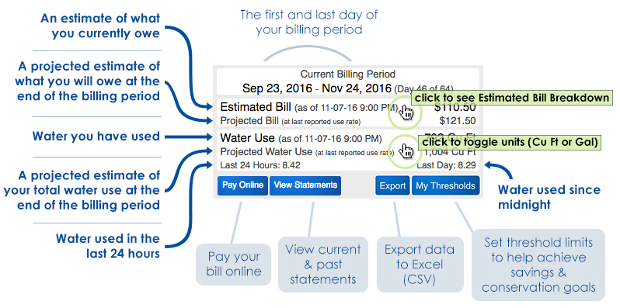
How Much Water Are You Buying?

Slide 9
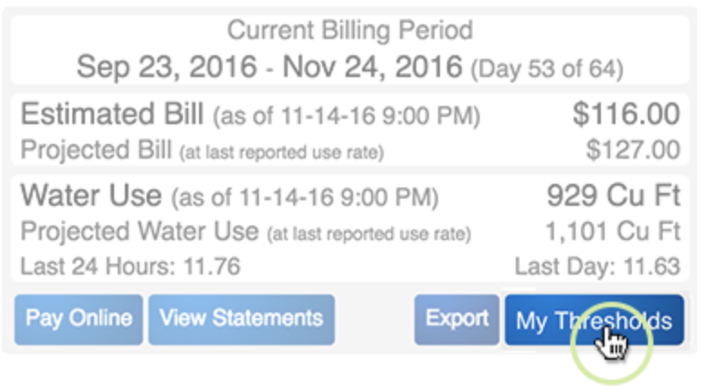
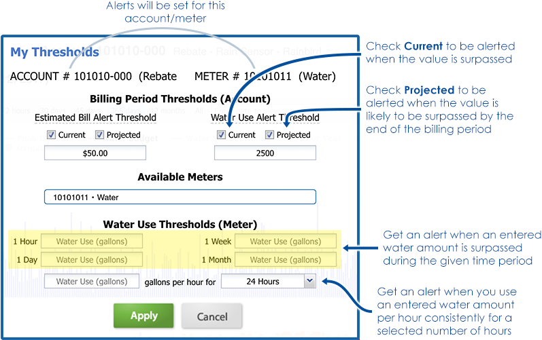
How to Control Your Bill?
Step 1: Click “My Thresholds”
Step 2: Set Preferences
$200.00

Slide 10
Questions & Answers

