Slide 1
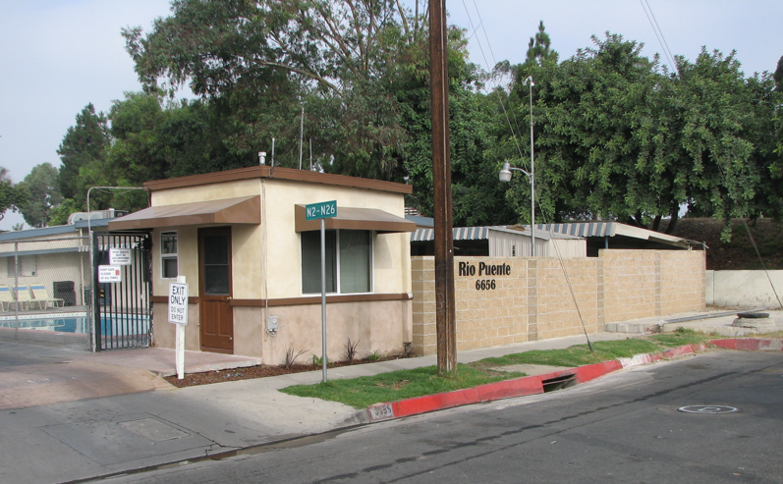
Summary of the Mobile Home Park MOU for Residents
Notes:
---

Slide 2
Mayor Olmos – welcome remarks and how we got here

Slide 3
AGENDA
Purposes of MOU
Rent Increase Amount
Vacancy Control
Capital Projects -- Rent Pass-Throughs
Property Tax – Rent Pass-Throughs
Transparency in Billing
Safety Net Program for Low-Income Residents
Record Keeping, Communication, Dispute Resolution, and Enforcement
Q & A
Notes:
---
This slide references information from the following file: https://paramountcity1957-my.sharepoint.com/personal/gchavez_paramountcity_gov/_layouts/15/Doc.aspx?sourcedoc=%7BA2747475-DE21-40D4-92A4-F8AD9AA7D2B5%7D&file=SUMMARY%20OF%20MOU-%20residents%20-%20english%20-spanish.docx&action=default&mobileredirect=true
The purpose of the Memorandum of Understanding (MOU) is to establish a fair and transparent framework for mobile home park operations within the City of Paramount. It aims to protect mobile home residents from unreasonable rent increases by establishing clear limitations and procedures for rent adjustments. The MOU ensures that park owners receive a reasonable return on investment, enabling maintenance and improvements that support long-term habitability. It also establishes communication channels so that residents and park owners can openly address concerns. Additionally, the MOU formalizes processes related to park improvements, cost passthroughs, and billing transparency, creating predictable and equitable standards for all parties. By setting rules for resident voting on certain improvement projects, outlining requirements for documentation, and providing pathways for dispute resolution, the MOU is designed to promote fairness and stability in mobile home communities. Ultimately, the agreement fosters collaboration and accountability between residents, park management, and the City, ensuring that all stakeholders understand their rights and responsibilities and can work together to maintain a healthy and transparent housing environment.

Slide 4
Purposes of the MOU
Fair Rent Regulation
  MOU protects residents by limiting unreasonable rent increases and setting clear rent adjustment procedures.
Reasonable Park Owner Returns
  Ensures park owners earn income sufficient to support maintenance and improvements for tenant’s quality of life while earning a fair return on their investment.
Open Communication Channels
  Establishes communication pathways for residents and owners to address concerns collaboratively.
Transparent Processes and Dispute Resolution
  Formalizes procedures for improvements, cost passthroughs, billing transparency, voting, documentation, and dispute resolution.
  Note: Does not apply to homes owned by Park owners; covered by State tenant protection rules.
Notes:
---
This slide references information from the following file: https://paramountcity1957-my.sharepoint.com/personal/gchavez_paramountcity_gov/_layouts/15/Doc.aspx?sourcedoc=%7BA2747475-DE21-40D4-92A4-F8AD9AA7D2B5%7D&file=SUMMARY%20OF%20MOU-%20residents%20-%20english%20-spanish.docx&action=default&mobileredirect=true
The purpose of the Memorandum of Understanding (MOU) is to establish a fair and transparent framework for mobile home park operations within the City of Paramount. It aims to protect mobile home residents from unreasonable rent increases by establishing clear limitations and procedures for rent adjustments. The MOU ensures that park owners receive a reasonable return on investment, enabling maintenance and improvements that support long-term habitability. It also establishes communication channels so that residents and park owners can openly address concerns. Additionally, the MOU formalizes processes related to park improvements, cost passthroughs, and billing transparency, creating predictable and equitable standards for all parties. By setting rules for resident voting on certain improvement projects, outlining requirements for documentation, and providing pathways for dispute resolution, the MOU is designed to promote fairness and stability in mobile home communities. Ultimately, the agreement fosters collaboration and accountability between residents, park management, and the City, ensuring that all stakeholders understand their rights and responsibilities and can work together to maintain a healthy and transparent housing environment.

Slide 5
Mh parks that have signed mou or in progress
Signed MOU IN PROGRESS
1.Cherryfield, 16707 Garfield Ave 1. Los Amigos, 8052 Alhambra
2.Cinderella, 8600 Contreras Street 2. Americana, 16600 Downey Ave
3.Metropolitan Estates, 16600 Orange Ave
4.Orange Avenue, 15325 Orange Ave
5.Californian Estates, 7101 Rosecrans Ave
6.Woodland Grove, 8610-8614 Flower Street
7.Kay’s Trailer Park, 14903 Garfield Ave
8.Rio Puente, 6656 Rosecrans Ave

Slide 6
Rent increase amount

Slide 7
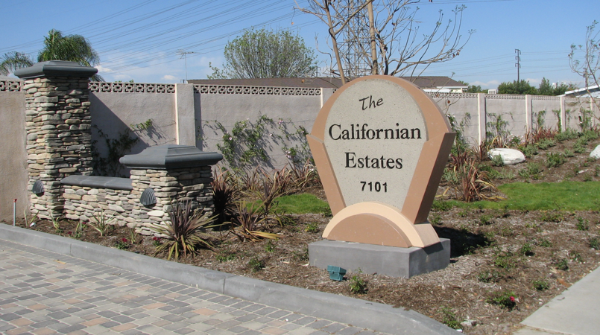
Rent Increases
Annual Rent Increase Limits
  Rent may increase only once per 12-month period, with a maximum cap of 3 percent.
Notes:
---
This slide references information from the following file: https://paramountcity1957-my.sharepoint.com/personal/gchavez_paramountcity_gov/_layouts/15/Doc.aspx?sourcedoc=%7BA2747475-DE21-40D4-92A4-F8AD9AA7D2B5%7D&file=SUMMARY%20OF%20MOU-%20residents%20-%20english%20-spanish.docx&action=default&mobileredirect=true
The MOU establishes clear limitations on how and when rent may be increased to safeguard residents from unreasonable annual adjustments. Under the agreement, rent may only increase once per year and the maximum annual rent increase is capped at 3 percent. This structure prevents sudden or unpredictable changes to housing costs. Vacancy adjustments are permitted only under specific conditions, such as when a home is sold or destroyed. In such cases, the park owner may set rent at market rate for the new resident, after which the 3 percent cap applies again. However, the MOU prohibits vacancy increases when residents transfer ownership within a family or move their home within the same park, ensuring continuity and preventing exploitation of internal household changes. Temporary removals of homes for improvements also cannot trigger vacancy increases. These rules provide strong tenant protections while enabling park owners to maintain operational flexibility. The section outlines precise definitions and protections intended to eliminate ambiguity and keep rent practices fair and consistent.

Slide 8
Vacancy control

Slide 9
Vacancy control – What is it?
It’s a rule that limits how much rent can increase when a housing space becomes vacant and a new mobilehome owner moves into the park, or when ownership of a mobilehome changes.
The purpose of vacancy control is to provide long-term affordability for subsequent homeowners and reduce incentives for park owners to evict tenants.

Slide 10
Vacancy control – When Rent adjustments are allowed
New Homeowner Renting a Vacant Space
Voluntary In‑Place Transfer (Home Sold to a Third Party)
Home Purchased Directly from Park Owner

Slide 11
Vacancy control -- When rent Adjustments Are
Not Allowed
Homeowner moves existing mobilehome to another vacant space
Temporary removal of mobilehome for park improvements or homeowner upgrades
Changes in ownership that keep the homeowner in residence
  Adding/removing co‑owners
  Transfers to another current resident relocating within the park
  Transfers to surviving joint tenant; heirs; personal representative upon death
  Transfers due to divorce/legal separation
  Transfer into a trust where homeowner remains beneficiary/trustee
Moving an existing mobilehome to a newly vacant space
  No increase for the homeowner who moves
  However, the space they vacated may receive a Vacancy Adjustment.

Slide 12
Capital Projects: rent Pass‑Throughs

Slide 13
Capital Projects
Categories:
Capital Improvement
        Examples: New parking areas/sidewalks /roads; new common area landscaping; new resident amenities such as play areas/pools/laundry rooms/common areas/bathrooms; construction of brand‑new buildings (clubhouse); and building expansions.
Capital Replacement
          Examples: Replacement or full reconstruction of existing streets; sidewalks; gates; lighting; drainage; recreational amenities; and water/sewer systems.
Repairs (Not included in Rent Pass Throughs
          Examples: Slurry seal of streets, replacement of street signs, repair of fallen bricks/stones/wood on an existing fence.

Slide 14
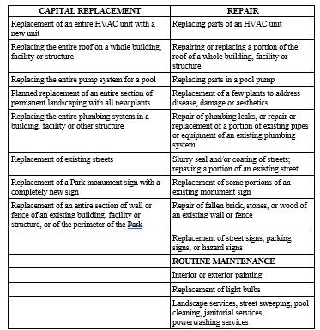
Examples – Capital replacement vs repairs
-- It’s in the Mou --

Slide 15
Capital improvement/replacement
Pass‑Through Adjustment
Max 4%* of base rent annual increase for pass‑throughs. Owners can recover up to 75% of total cost for capital replacements or capital improvements.
  Example: $1,000 (your monthly base rent) * 4% = $40 added to your rent
  Pass-through adjustment is not included in rent to calculate future rent increases.
  Pass-through adjustment must be separately listed on the monthly rent statement.
  Pass-through adjustment is temporary and must be removed once the project cost is paid off.
Notice of Increase. Owner must provide the affected Spaces with at least ninety (90) days written notice of the proposed Capital Project Pass-Through Adjustment.
*Includes adjustments for Emergency Capital Replacements, Major Water or Sewer Capital Projects, and other Capital Improvements or Replacements, plus Pre‑MOU pass‑throughs.

Slide 16
Capital improvements – requires ballot election
Must meet all criteria to qualify as a “capital improvement”:
      Must be new construction, not replacement of existing infrastructure, and not required due to deferred maintenance.
Built for purposes other than maintenance/repair
      Completed after MOU effective date and by current owner
      Located in the park, primarily benefits residents, and adds material value
      Value of at least $40,000+ (or $20,000+ for small parks – less than 30 homes)
Has a life expectancy of 5+ years
      Cost must be amortized over useful life
      Cannot combine with unrelated projects to meet minimum value
Utility system projects (gas, electric, CPUC‑regulated) are not Capital Improvements.
At least two bids solicited; lowest qualified bidder selected or written justification provided

Slide 17
Capital Improvements pass-through –
BALLOT procedures
60‑Day (before Construction) Written Notice to Homeowners & City
Notice must include: Description of proposed Capital Improvement; estimated start and completion dates; full cost estimate itemized; contract availability for resident review; financing details (lender, interest rate, terms)
• Date/time of the ballot election set by the City Clerk
Notice may be mailed or posted on each home
Pre‑Construction Meeting (30‑Day Requirement)
At least 30 days before construction, Owner must meet with Homeowners, Residents, and the Oversight Board.
Must post and serve meeting notice 15 days in advance.
During the meeting, Owner must provide: Summary of project scope and full cost breakdown; reasons for the Capital Improvement; summary of all bids received; explanation of contractor selection

Slide 18
Capital Improvements pass-through –
BALLOT procedures (continued)
City of Paramount City Clerk conducts election 30 days before construction.
One ballot per mobilehome space.
Requires majority approval (50% + 1) of occupied spaces. Without majority approval, costs cannot be passed through.
Notice of election must be posted and served at least 15 days before the vote. City Clerk counts ballots, maintains confidentiality, and posts/serves results.
Owner must post and distribute results within 5 days and file proof with City Clerk.
Implementation - If approved and construction is completed; the Owner may implement the Pass‑Through Rent Adjustment.

Slide 19
Capital replacements – no ballot election
Must replace an entire portion of existing facilities and be permanently fixed with a life expectancy of 5+ years.
Not included: routine maintenance, deferred‑maintenance repairs, code‑compliance corrections, CPUC‑regulated utility systems, furniture/equipment, work done by staff or long‑term contractors, or any costs covered by insurance.
Must benefit residents, be completed by the current owner, and meet all requirements:
• Value of at least $40,000+ (or $20,000+ for small parks)
• Costs must be amortized over useful life
• Two bids required; lowest qualified bidder or written justification
• Pre‑construction notification required (except for emergencies); consent from homeowners is not required

Slide 20
Capital Replacement -- no ballot election
Pre‑Notification Requirements
30‑day written notice required before starting a Capital Replacement. Notice must go to all Homeowners, the Homeowner Oversight Board, and the City.
Notice must include:
• Description of planned replacement; estimated start date; estimated cost
• Statement that it qualifies as a Capital Replacement under the MOU
Notice may be mailed or posted on each unit.
Failure to provide notice means the Owner cannot later pass through any project costs to residents.
After notice, any resident or the Oversight Board may request an informal meeting with the Owner to discuss need, scope, and resolve issues.

Slide 21
Emergency Capital Replacement – no ballot election
Required due to a disaster‑related event.
Necessary to prevent an imminent threat to health and safety for the park, residents, or surrounding area.
Must be completed immediately.
Must still meet all other Capital Replacement requirements under the MOU.
Emergency Capital Replacements may proceed without 30‑day notice if:
• No time existed to provide notice due to imminent health/safety threat
• Owner gave at least 5 days written notice to the Oversight Board (or shorter if necessary) with scope, estimated costs, and timeline
• Construction began within 14 days of the disaster event and was completed as quickly as possible
• Owner provided notice and documentation to the City and residents within 5 days after construction began
Emergency projects may be passed through only for costs above the first $40,000 (or $20,000 for small parks).

Slide 22
Major Water / sewer capital project – no ballot election
A project that replaces or upgrades more than 75% of a park’s water or sewer system.
Must be mandated by a new law/regulation or required by the park’s insurance company due to specific health or safety concerns.
Does NOT include projects caused by unreasonably deferred maintenance or those required because the original installation or later repairs were not code-compliant.
Ballot election is NOT required.

Slide 23
Capital Project pass through adjustment --
Protest procedures
Who can file: Any Homeowner, the Homeowner Oversight Board, or their authorized representative.
When: Must file a protest within 15 days of the Park Owner’s 90‑day notice of a Capital Project Pass‑Through Adjustment.
Where: Filed with the City’s Planning & Building Director, including all documentation. Director must issue a decision within 30 days; may appoint a hearing officer for review and recommendation.

Slide 24
Capital Project pass through adjustment –
Protest procedures (continued)
Grounds for Protest may include:
• Project resulted from deferred maintenance
• Project required only to fix non‑code‑compliant installation/repairs
• Work was routine maintenance, not a Capital Improvement/Replacement
• Project completed before MOU effective date
• Project not carried out by or for current park owner
• Project primarily benefits owner, not residents
• Less than 5‑year life expectancy
• Incorrect amortization period
• Does not meet minimum value thresholds ($40k or $20k for small parks)
• Costs are excessive or bidding requirements not followed
• Incorrect classification as Emergency or Major Water/Sewer Project

Slide 25
Capital Project pass through rent adjustment – arbitration procedures
Arbitration Procedure (must go through protest procedures first)
Who can request: Park Owner, Homeowner(s), or Oversight Board.
When: Must request arbitration within 30 days of the Director’s decision on a protest.
Process:
  Binding arbitration through the American Arbitration Association, or another mutually agreed service.
  Arbitrator’s decision is final and enforceable.
  Costs shared equally between Park Owner and Homeowners.
Within 30 days of the arbitrator’s decision, Owner must submit a modified rent schedule reflecting the final determination.

Slide 26
Property Tax: rent Pass‑Throughs

Slide 27
Property Tax pass through upon park re-sale
When the park is sold, the new owner may pass through property tax increases above 2% from the prior fiscal year.
Increase is phased in over a minimum of 5 years with equal annual increases per space.
After Year 5, the Year‑5 amount continues until a new reassessment or tax reduction.
Pass‑through is separately itemized, not part of rent, and not included in the 4% Pass‑Through Cap.
Homeowners may request mediation, but the adjustment is not subject to protest or arbitration.
Notes:
---
This slide references information from the following file: https://paramountcity1957-my.sharepoint.com/personal/gchavez_paramountcity_gov/_layouts/15/Doc.aspx?sourcedoc=%7BA2747475-DE21-40D4-92A4-F8AD9AA7D2B5%7D&file=SUMMARY%20OF%20MOU-%20residents%20-%20english%20-spanish.docx&action=default&mobileredirect=true
When a mobile home park is sold, property taxes may increase for the new owner. The MOU allows park owners to pass through only the portion of these property tax increases that exceeds 2 percent over the prior fiscal year’s taxes under the previous owner. These passthroughs must be evenly amortized over five years, distributing the financial impact fairly across residents. Importantly, the property tax passthrough does not count toward the 4 percent passthrough cap applicable to capital improvement charges, nor does it factor into rent increase calculations, meaning it remains separate from base rent and the annual 3 percent rent cap. By structuring the passthrough in this way, the MOU ensures transparency, prevents sudden and unpredictable rent changes due to property transfers, and protects residents from bearing disproportionate costs while still allowing park owners to responsibly manage increased tax obligations resulting from a sale.

Slide 28
Transparency in billing

Slide 29
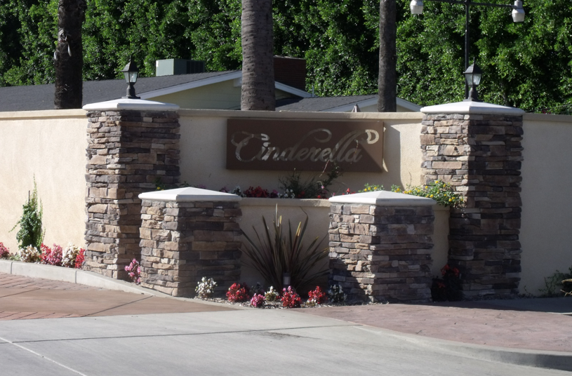
Transparency in Billing
Itemized Billing Requirements
  Monthly rent statements must include detailed line items for base rent, rent increases, MOU pass-through adjustments with project details, and pre-MOU pass-throughs.
Pass-through Charge Transparency
  For each Pass-through adjustment, the monthly rent statement must list project purpose, total cost, dates, and amortization schedules to provide full transparency.
Notes:
---
This slide references information from the following file: https://paramountcity1957-my.sharepoint.com/personal/gchavez_paramountcity_gov/_layouts/15/Doc.aspx?sourcedoc=%7BA2747475-DE21-40D4-92A4-F8AD9AA7D2B5%7D&file=SUMMARY%20OF%20MOU-%20residents%20-%20english%20-spanish.docx&action=default&mobileredirect=true
The MOU requires park owners to maintain clear, detailed, and transparent billing practices to ensure residents understand their monthly charges. Each monthly rent statement must include separate line items for base rent, annual rent increases with effective dates, all passthrough charges, and their associated project details. Passthrough listings must include project purpose, total cost, start and end dates, and amortization schedules. Additional pre-MOU passthroughs or state-authorized fees must also be clearly displayed. This level of transparency helps residents track changes, verify compliance with MOU rules, and avoid unexpected charges. When amortization periods end, the owner must remove the corresponding charges from billing immediately. These requirements provide clarity, prevent billing disputes, and foster trust between residents and park management. In addition, they support the enforcement provisions of the MOU by documenting compliance and offering residents a clear record of cost allocations and project histories.

Slide 30
Safety net program

Slide 31
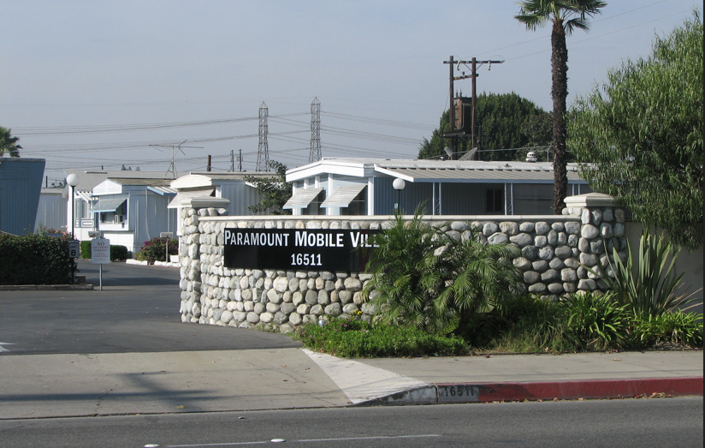
Safety Net Program for Low-Income Residents
Eligibility Criteria
  Households must have income less than or equal to twice monthly rent and assets under $50,000, excluding home and vehicles.
Rent Assistance Limits
  Rent assistance ensures rent does not exceed 33% of household income, capped at $150 per month to aid affordability.
Program Administration
  Park owners are required to administer the program, ensuring fair rent increases and protecting vulnerable residents.
Notes:
---
This slide references information from the following file: https://paramountcity1957-my.sharepoint.com/personal/gchavez_paramountcity_gov/_layouts/15/Doc.aspx?sourcedoc=%7BA2747475-DE21-40D4-92A4-F8AD9AA7D2B5%7D&file=SUMMARY%20OF%20MOU-%20residents%20-%20english%20-spanish.docx&action=default&mobileredirect=true
The MOU establishes a mandatory Safety Net Program to support low-income residents who are most vulnerable to financial hardship. Eligible households must have an income less than or equal to twice the monthly rent and assets under $50,000, excluding their home, furnishings, and vehicles. The program ensures that rent does not exceed 33 percent of household income, with assistance capped at $150 per month. Residents must apply annually and have lived in the park for at least one year to qualify. This program provides significant financial support while helping maintain housing stability among long-term residents. By formally requiring park owners to administer this program, the MOU recognizes the financial challenges facing many mobile home households and ensures that rent increases, passthroughs, and other charges do not disproportionately burden those with limited incomes. It also reflects the City’s commitment to protecting its most vulnerable residents and preserving affordability in mobile home communities.

Slide 32
Record Keeping, Communication, Dispute Resolution, and Enforcement

Slide 33

Registration and Recordkeeping Requirements
Filing Rent Schedules
  Park owners must submit initial and annual rent schedules with detailed rent rolls to the City for transparency.
Maintaining Records Onsite
  Parks must keep updated copies of the MOU, rules, utility info, and documents available for resident review.
Resident Access and Rights
  Residents can request full copies of the MOU, supporting informed decision-making.
Promoting Transparency and Trust
  Clear documentation promotes regulatory enforcement, community trust, and dispute prevention before issues arise.
Notes:
---
This slide references information from the following file: https://paramountcity1957-my.sharepoint.com/personal/gchavez_paramountcity_gov/_layouts/15/Doc.aspx?sourcedoc=%7BA2747475-DE21-40D4-92A4-F8AD9AA7D2B5%7D&file=SUMMARY%20OF%20MOU-%20residents%20-%20english%20-spanish.docx&action=default&mobileredirect=true
The MOU outlines several administrative requirements to promote transparency and ensure that residents have access to essential information. Park owners must file both initial and annual rent schedules with the City, along with detailed rent rolls. They must also maintain up-to-date copies of the MOU, park rules, utility information, and required documents in the park office for resident review. Prospective residents must receive a summary of the MOU and may request a full copy. By mandating clear and accessible documentation, the MOU helps residents make informed decisions and ensures consistent oversight of rent practices. These requirements also support regulatory enforcement by providing the City with accurate and timely records. Residents benefit from understanding their rights and responsibilities and from having access to the historical context of rent charges and park operations. This foundation of easily accessible information promotes community trust and helps prevent disputes before they arise.

Slide 34

Communication Framework
Homeowner Oversight Board/Park Management Committee
  Each park forms a board to serve as a liaison between residents and management, meeting regularly to discuss concerns; comply with MRL. Owner to respond to concerns submitted in writing within 30 days after meeting.
Citywide MOU Working Group
  A group consisting of home owners, park owners, and city representatives meeting at City Hall to discuss issues and support MOU implementation. Meetings twice in the first year. Apply to serve before August 31, 2026. Appointment for 5 year term.
Notes:
---
This slide references information from the following file: https://paramountcity1957-my.sharepoint.com/personal/gchavez_paramountcity_gov/_layouts/15/Doc.aspx?sourcedoc=%7BA2747475-DE21-40D4-92A4-F8AD9AA7D2B5%7D&file=SUMMARY%20OF%20MOU-%20residents%20-%20english%20-spanish.docx&action=default&mobileredirect=true
The MOU establishes structured communication channels aimed at improving relationships between residents and park management. Each park must form a Homeowner Oversight Board, which serves as a liaison between residents and management. Park owners must meet with this board upon reasonable notice, no more than once every 30 days. This requirement ensures that residents have a regular forum to raise concerns and engage in constructive dialogue with management. Individual residents may also meet privately with management to address personal issues. In addition, the MOU creates a Citywide Working Group consisting of residents, park owners, and City representatives. This group meets during the first year of the MOU’s implementation to discuss emerging issues and support successful rollout. The communication framework fosters long-term cooperation, helps mediate concerns before they escalate, and ensures that all voices are heard in ongoing park operations.

Slide 35

Dispute Resolution
Written Notice and Mediation - Process
Applies to disputes between:
• Park Owner and City (MOU interpretation/enforcement issues)
• Park Owner and Homeowners / Oversight Board (disputes over Property Tax Pass-Through Adjustments; other MOU interpretation or enforcement issues)
The party alleging a violation must:
• Provide written notice describing the dispute
• Send notice to the opposing party and the City
If issue is not resolved within 30 days, parties must first attempt mediation using a third‑party mediation service.
Notes:
---
This slide references information from the following file: https://paramountcity1957-my.sharepoint.com/personal/gchavez_paramountcity_gov/_layouts/15/Doc.aspx?sourcedoc=%7BA2747475-DE21-40D4-92A4-F8AD9AA7D2B5%7D&file=SUMMARY%20OF%20MOU-%20residents%20-%20english%20-spanish.docx&action=default&mobileredirect=true
The MOU provides structured processes to resolve disputes fairly and efficiently. For property tax passthrough disagreements, residents may request mediation with the park owner. This allows both parties to discuss concerns informally and attempt resolution before escalating the matter. For disputes regarding capital improvement or replacement passthroughs, residents must file a formal protest with the City. If the City’s decision does not satisfy either party, the dispute may be appealed to binding arbitration, providing a neutral and enforceable resolution mechanism. These pathways create clear steps for residents to challenge charges they believe violate MOU guidelines, while also offering owners a structured process for resolving disagreements. The dispute resolution system aims to minimize conflict, reduce legal costs, and promote equitable outcomes grounded in the rules of the MOU.

Slide 36
Dispute Resolution, cont.
Any party may propose an alternative mediation service, but must pay for it.
Parties should make a good‑faith effort to resolve disputes through mediation before filing suit, unless a statute of limitations requires filing a protective action.
Park Owner must continue providing services and amenities.
Homeowners must continue paying rent.

Slide 37

Enforcement
Remedies
A. City Enforcement
If the Park Owner violates the MOU, the City may take legal action on behalf of affected Residents to enforce MOU terms.
B. Homeowner Enforcement
Homeowners and the Homeowner Oversight Board are third‑party beneficiaries of the MOU.
They may file a civil action to enforce the MOU or seek damages for violations.
C. Park Owner Rights
The MOU does not prevent the Park Owner from enforcing park rules and regulations, as long as those rules do not conflict with the MOU.
Notes:
---
This slide references information from the following file: https://paramountcity1957-my.sharepoint.com/personal/gchavez_paramountcity_gov/_layouts/15/Doc.aspx?sourcedoc=%7BA2747475-DE21-40D4-92A4-F8AD9AA7D2B5%7D&file=SUMMARY%20OF%20MOU-%20residents%20-%20english%20-spanish.docx&action=default&mobileredirect=true
The MOU grants both the City and residents enforcement authority to ensure proper compliance. The City may take legal or administrative action on behalf of residents if violations occur. Additionally, residents and the Homeowner Oversight Board may independently sue park owners for noncompliance. These enforcement tools ensure that the MOU’s rules are meaningful and backed by legal accountability. By empowering multiple parties to enforce its provisions, the MOU supports consistent adherence and discourages violations related to rent practices, passthrough procedures, documentation, and communication obligations. This framework builds trust in the MOU by guaranteeing that improper actions can be formally addressed, safeguarding resident rights and ensuring fair administration of mobile home park operations.

Slide 38
Mh mou website
View the City webpage for copy of the MOU and future information on meetings, updates, etc.
https://www.paramountcity.gov/government/departments/administrative-services/mobile-homes/
www.paramountcity.gov Type in Mobile Homes under search box.
If you need copy of the MOU mailed to you, please call 562-220-2022 or email gchavez@paramountcity.gov

Slide 39
question & answer period

